Slide 1


Slide 2


Wakeel
AI Legal Assistant for Family Law
Amna Raza Khan 24280055 | Amna Shahnawaz 23030024 | Hisham Fawad 24280041 | Yahya Habib 24280001

Slide 3





WAKEEL
AI Legal Assistant for legal advice, drafting, and case law search tailored to Pakistan’s family law landscape.
PROBLEM
SOLUTION
WHY US?
Legal documents are difficult to understand due to complex jargon.
Affordable, accessible legal advice is scarce.
Overburdened, less tech-savvy lawyers lack structured AI assistance for routine legal tasks.
Offer quick and cost-effective legal advice for the public.
Help lawyers generate petitions and contracts efficiently.
Assist law students and researchers in retrieving case law precedents.
First AI assistant fine-tuned for Pakistani family law.
Combines RAG with fine-tuned models for context-aware drafting and legal consulting.
Uses 70 years of court precedents in a searchable legal knowledge base.
Beneficiaries: General Public, Legal Aid NGOs, Lawyers and Law Firms, Students and Researchers

Slide 4
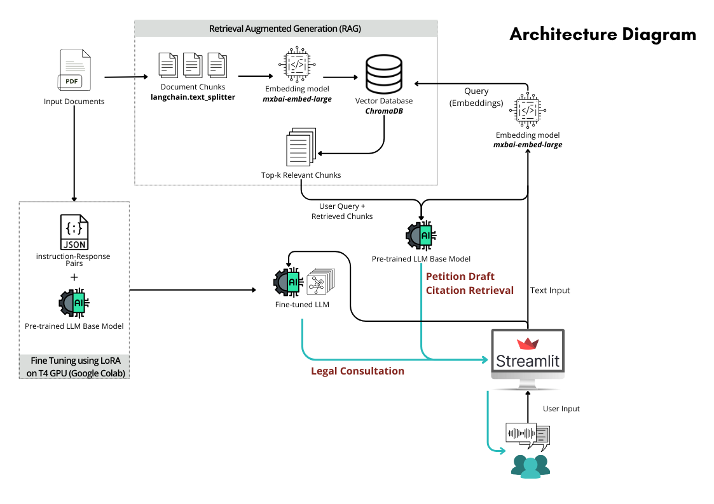

Slide 5
Phase | Status
Phase 1: Problem Understanding (Weeks 1–3) | ✅ Completed
Phase 2: Product Ideation (Weeks 4–5) | ✅ Completed
Phase 3: AI Prototyping (Weeks 6–9) | ✅ Completed
Phase 4: Evaluation & Improvements (Weeks 10–14) | 🔄 In Progress (Evaluation, Audio Integration)

Slide 6
EVALUATION
What’s Working Well?
LLM-as-a-Judge
Qualitative Spot Checks
Legal Drafting Tab: Accurately generates petitions like Khula using fine-tuned LLM.
Citation Retrieval Tab: Quickly retrieves relevant case law precedents using RAG pipeline.
Legal Consultation Tab: Offers quick and cost-effective legal advice for the public.
Correctness: Compares generated legal drafts to expert-written references.
Completeness: Assesses whether all relevant legal sections are included.
Citations Relevance: Checks whether retrieved case laws match the legal query context.
Conducted Internal evaluations comparing outputs across models (DeepSeek, LLaMA3, Mistral).
Draft quality reviewed by team with legal annotations from law students.
Structured evaluation with lawyer planned this week.

Slide 7
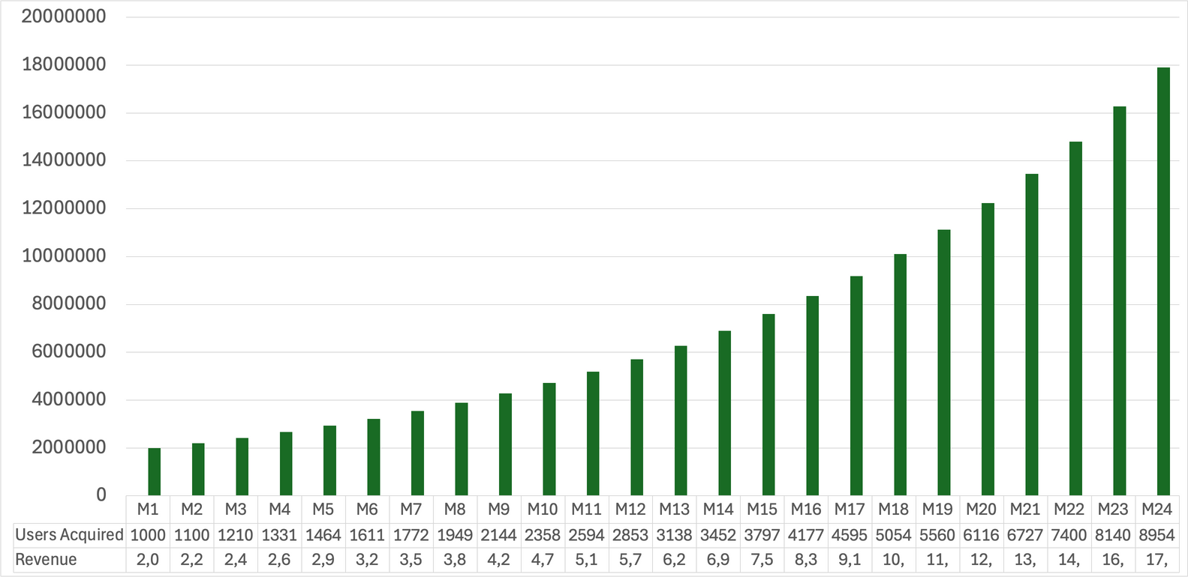
Business Case
Market Potential
Market Size | 150,000
Market Potential | 300,000,000
Cost | 1,600,000
Number of Users | 1000
Subscription Charges /Month | 2,000
Revenue - 1st Thousand Users | 2,000,000
2 year Cumulative Revenue | 176,994,654
Training Cost Required
Costs
Data Annotation | Free
Hardware
100 million Open AI token | 2,250,000
AWS | 600,000
UI/UX - One Time Cost | 4,500,000
Cost Per Month | 1,600,000
Training Cost - One Time Cost | 4,500,000

Slide 8
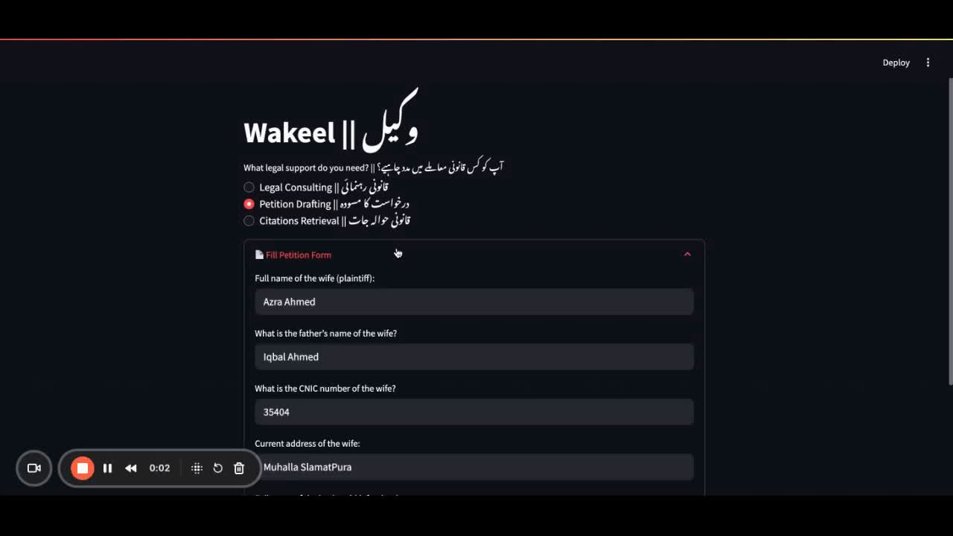

Slide 9


QUESTIONS?

